Slide 1
features: Higher order&Currying

Slide 2
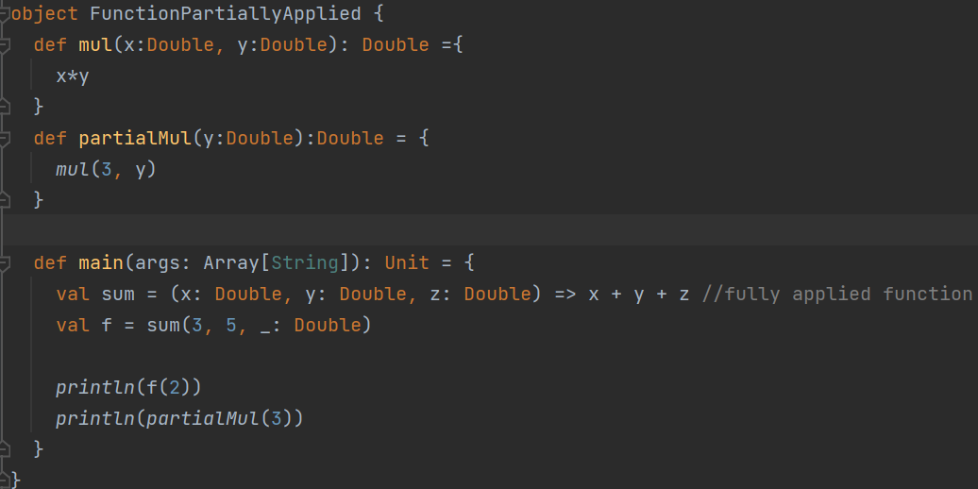



Partially Applied Function
Notes:
object FunctionPartiallyApplied { def mul(x:Double, y:Double): Double ={ x*y } def partialMul(y:Double):Double = { mul(3, y) } def main(args: Array[String]): Unit = { val sum = (x: Double, y: Double, z: Double) => x + y + z //fully applied function val f = sum(3, 5, _: Double) println(f(2)) println(partialMul(3)) }

Slide 3
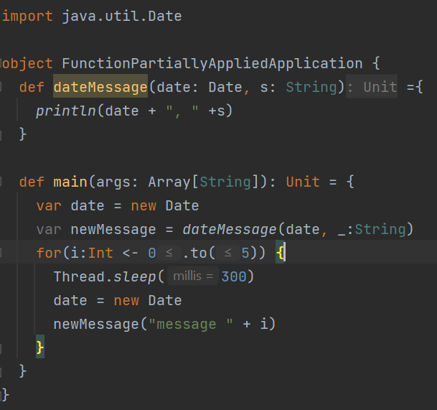
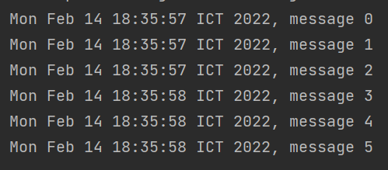


Partially applied function (application)
Notes:
import java.util.Date object FunctionPartiallyAppliedApplication { def dateMessage(date: Date, s: String) ={ println(date + ", " +s) } def main(args: Array[String]): Unit = { var date = new Date var newMessage = dateMessage(date, _:String) for(i:Int <- 0.to(5)) { Thread.sleep(300) date = new Date newMessage("message " + i) } } }

Slide 4
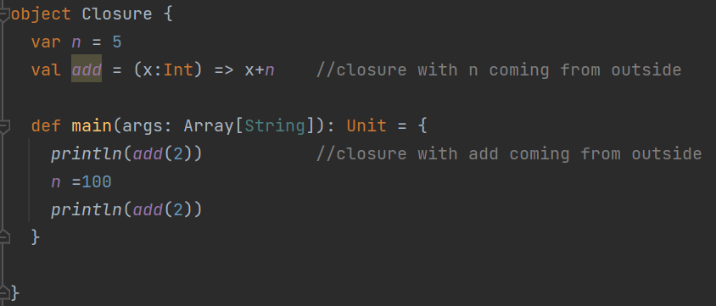


Closure
A function that uses variable(s) declared outside the function.
Notes:
object Closure { var n = 5 val add = (x:Int) => x+n //closure with n coming from outside def main(args: Array[String]): Unit = { println(add(2)) //closure with add coming from outside n =100 println(add(2)) } }

Slide 5
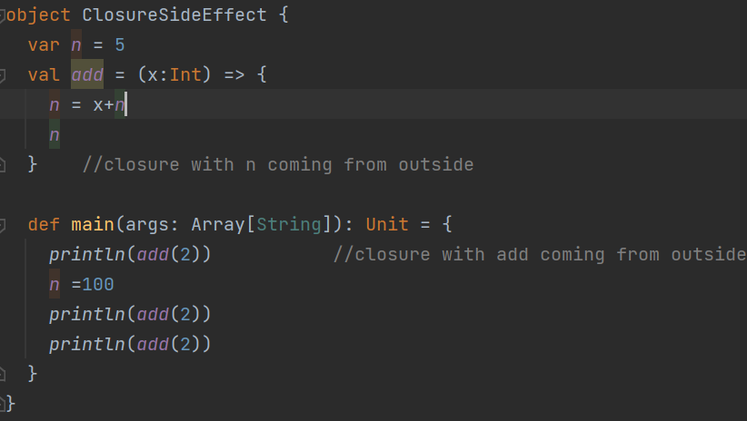

Closure – with side effect allowed on variable (impure closure))
Notes:
object ClosureSideEffect { var n = 5 val add = (x:Int) => { n = x+n n } //closure with n coming from outside def main(args: Array[String]): Unit = { println(add(2)) //closure with add coming from outside n =100 println(add(2)) println(add(2)) } }

Slide 6
What is functional programming?
No changing variable.
No assignment
No loop
Just focusing on functions.
Functions can be defined anywhere, including in other functions.
Functions can be passed as parameters and returned as results.
There are operators that can compose functions.

Slide 7
What are good about functional programming?
Simpler reasoning.
Good for multicore and cloud computing.
Avoid modifying variables by different parts of the program.
Places to use (where we want scalable solutions)
Web
Trading platforms
Simulation

Slide 8
Evaluating function == evaluating expression
This substitution model (evaluating until getting a value) can be used as long as the function has no side effect.
square(square(2))
square(4)
16
Example of side effect (cannot be expressed in a substitution model)
x++

Slide 9
Recursion is important in this paradigm.
Need to be able to think of it instead of loop.
Recursion can be optimized to use only 1 stack frame (if you convert it to tail-recursion)
But first, you must be more familiar with recursion.

Slide 10
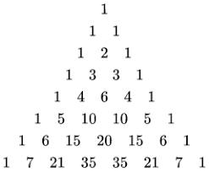
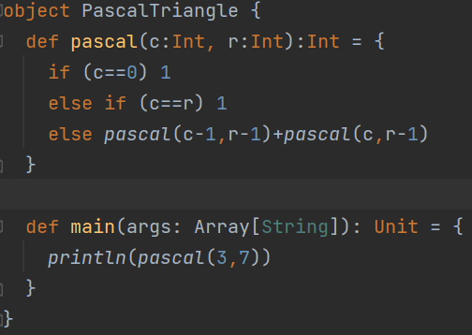
Pascal’s triangle (recursion exercise – 5 mins)
def pascal(c: Int, r: Int): Int
Returns the number at column c in row r
, where c and r start at 0, and value of c never exceeds value of r.
Notes:
object PascalTriangle { def pascal(c:Int, r:Int):Int = { if (c==0) 1 else if (c==r) 1 else pascal(c-1,r-1)+pascal(c,r-1) } def main(args: Array[String]): Unit = { println(pascal(3,7)) } }

Slide 11
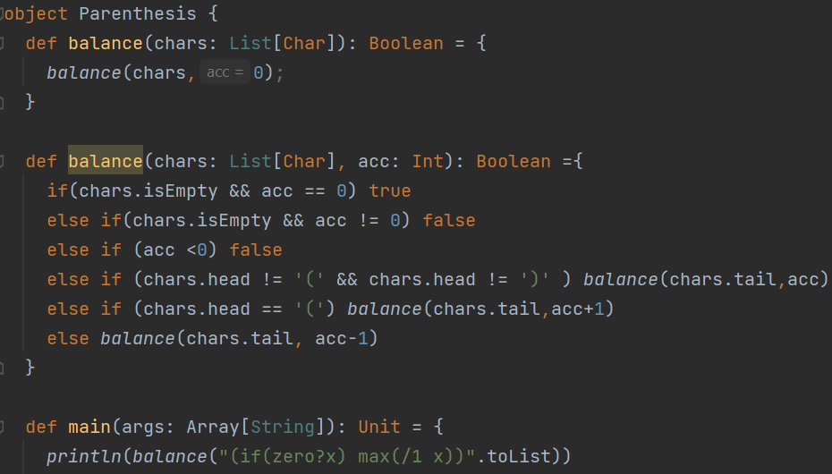
Parenthesis Balancing exercise (recursive 15 mins)
def balance(chars: List[Char]): Boolean
())( -> must return false
chars.isEmpty: Boolean checks if the list is empty.
chars.head: Char returns the first element of the list.
chars.tail: List[Char] returns the list with the first element removed.
In your test, you can use the toList method to convert from a String to aList[Char]:
e.g. “I (John Mcclain) is a Die Hard fan".toList.
Notes:
object Parenthesis { def balance(chars: List[Char]): Boolean = { balance(chars,0); } def balance(chars: List[Char], acc: Int): Boolean ={ if(chars.isEmpty && acc == 0) true else if(chars.isEmpty && acc != 0) false else if (acc <0) false else if (chars.head != '(' && chars.head != ')' ) balance(chars.tail,acc) else if (chars.head == '(') balance(chars.tail,acc+1) else balance(chars.tail, acc-1) } def main(args: Array[String]): Unit = { println(balance("(if(zero?x) max(/1 x))".toList)) println(balance("I told him (that it’s not (yet) done). (But he wasn't listening)".toList)) println(balance(":-)".toList)) println(balance("())(".toList)) } }

Slide 12
Tail recursion
If a function just calls another or call itself without any extra work, the language runtime system can optimize the function to use only one stack frame, just like using a loop.
If you see a recursive function that is not tail-recursive, trying to make it tail-recursive will help optimize memory (stack frame) usage.

Slide 13
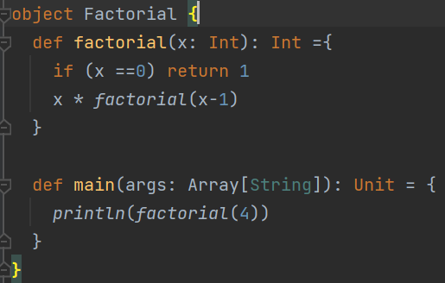

Factorial (non tail-recursive)

Slide 14
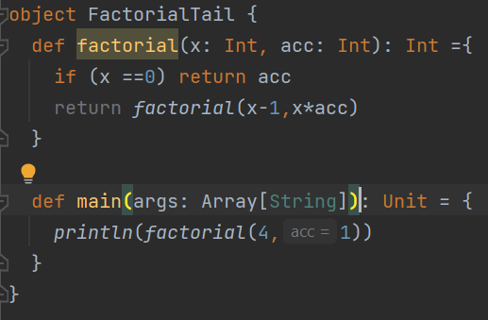
Factorial (Tail-recursive) -exercise 5 mins
Notes:
object FactorialTail { def factorial(x: Int, acc: Int): Int ={ if (x ==0) return acc return factorial(x-1,x*acc) } def main(args: Array[String]): Unit = { println(factorial(4,1)) } }

Slide 15
Higher order function
Take functions as arguments.
Can return function.

Slide 16
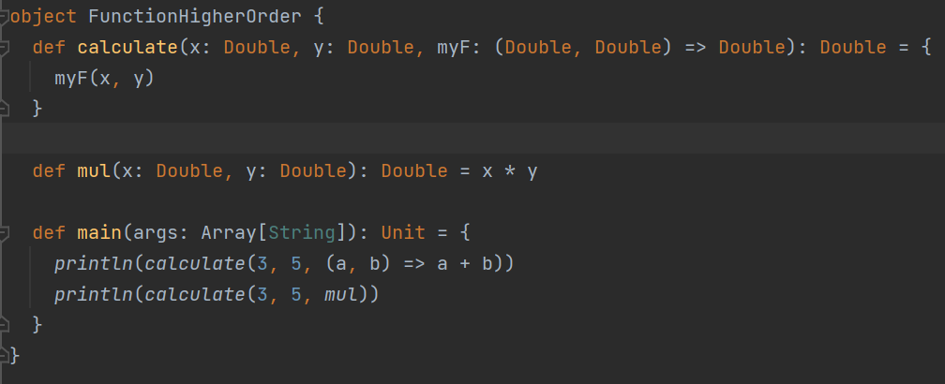

Function as parameter
Notes:
object FunctionHigherOrder { def calculate(x: Double, y: Double, myF: (Double, Double) => Double): Double = { myF(x, y) } def mul(x: Double, y: Double): Double = x * y def main(args: Array[String]): Unit = { println(calculate(3, 5, (a, b) => a + b)) println(calculate(3, 5, mul)) } }

Slide 17
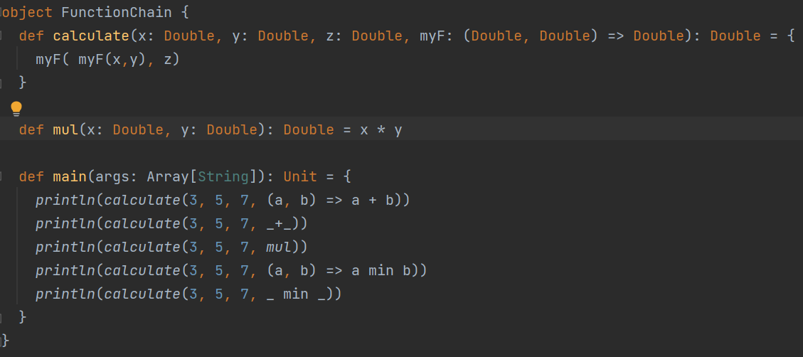
Chaining functions
Notes:
object FunctionChain { def calculate(x: Double, y: Double, z: Double, myF: (Double, Double) => Double): Double = { myF( myF(x,y), z) } def mul(x: Double, y: Double): Double = x * y def main(args: Array[String]): Unit = { println(calculate(3, 5, 7, (a, b) => a + b)) println(calculate(3, 5, 7, _+_)) println(calculate(3, 5, 7, mul)) println(calculate(3, 5, 7, (a, b) => a min b)) println(calculate(3, 5, 7, _ min _)) } }

Slide 18
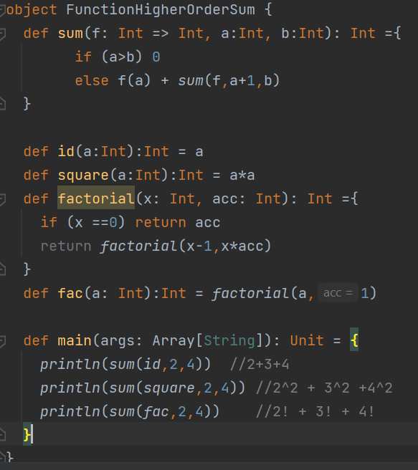



Let’s define $\sum_{n=a}^{b}{f}\left(n\right)$ where f can be any function
Notes:
object FunctionHigherOrderSum { def sum(f: Int => Int, a:Int, b:Int): Int ={ if (a>b) 0 else f(a) + sum(f,a+1,b) } def id(a:Int):Int = a def square(a:Int):Int = a*a def factorial(x: Int, acc: Int): Int ={ if (x ==0) return acc return factorial(x-1,x*acc) } def fac(a: Int):Int = factorial(a,1) def main(args: Array[String]): Unit = { println(sum(id,2,4)) //2+3+4 println(sum(square,2,4)) //2^2 + 3^2 +4^2 println(sum(fac,2,4)) //2! + 3! + 4! } }

Slide 19
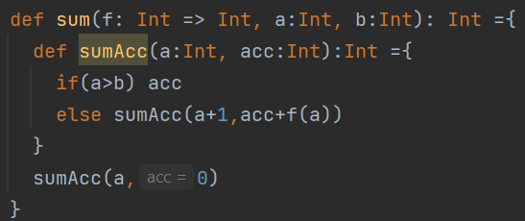
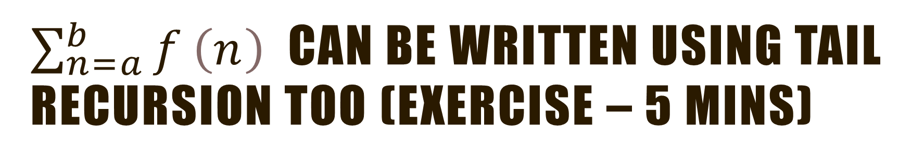
$\sum_{n=a}^{b}{f}\left(n\right)$ can be written using tail recursion too (exercise – 5 mins)
Write only the definition of function sum
Notes:
def sum(f: Int => Int, a:Int, b:Int): Int ={ def sumAcc(a:Int, acc:Int):Int ={ if(a>b) acc else sumAcc(a+1,acc+f(a)) } sumAcc(a,0) }

Slide 20
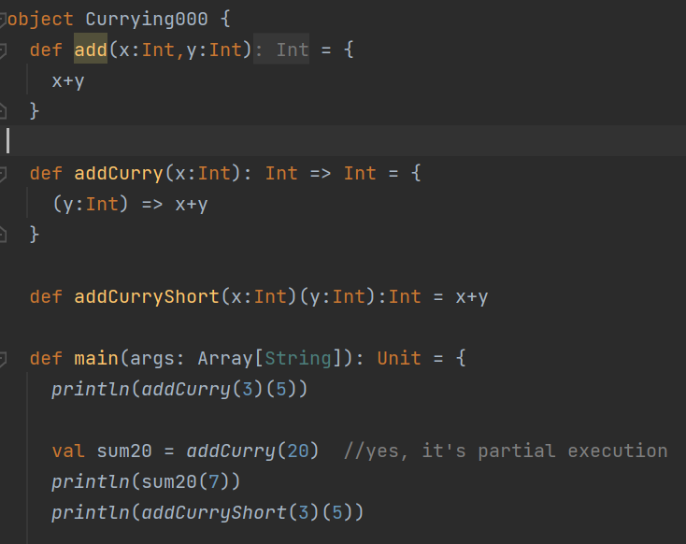


Currying - function as return value
Function with multiple arguments ->
Function with one argument, returning another function.
Notes:
object Currying000 { def add(x:Int,y:Int) = { x+y } def addCurry(x:Int): Int => Int = { (y:Int) => x+y } def addCurryShort(x:Int)(y:Int):Int = x+y def main(args: Array[String]): Unit = { println(addCurry(3)(5)) val sum20 = addCurry(20) //yes, it's partial execution println(sum20(7)) println(addCurryShort(3)(5)) } }

Slide 21
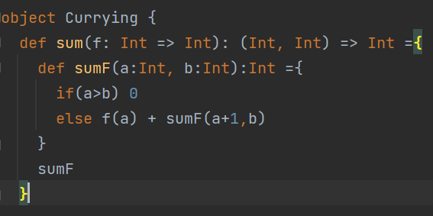
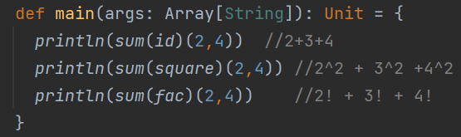

Currying –
Example on $\sum_{n=a}^{b}{f}\left(n\right)$
Notes:
object Currying { def sum(f: Int => Int): (Int, Int) => Int ={ def sumF(a:Int, b:Int):Int ={ if(a>b) 0 else f(a) + sumF(a+1,b) } sumF } def id(a:Int):Int = a def square(a:Int):Int = a*a def factorial(x: Int, acc: Int): Int ={ if (x ==0) return acc return factorial(x-1,x*acc) } def fac(a: Int):Int = factorial(a,1) def main(args: Array[String]): Unit = { println(sum(id)(2,4)) //2+3+4 println(sum(square)(2,4)) //2^2 + 3^2 +4^2 println(sum(fac)(2,4)) //2! + 3! + 4! } }

Slide 22
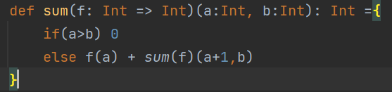
Currying – special syntax (multiple parameter list)
The type of this function is
(Int => Int) => ((Int,Int) => Int) or (Int => Int) => (Int,Int) => Int
Since function types are right associative, so Int => Int => Int is equivalent to Int => (Int => Int)
Notes:
object Currying02 { def sum(f: Int => Int)(a:Int, b:Int): Int ={ if(a>b) 0 else f(a) + sum(f)(a+1,b) } def id(a:Int):Int = a def square(a:Int):Int = a*a def factorial(x: Int, acc: Int): Int ={ if (x ==0) return acc return factorial(x-1,x*acc) } def fac(a: Int):Int = factorial(a,1) def main(args: Array[String]): Unit = { println(sum(id)(2,4)) //2+3+4 println(sum(square)(2,4)) //2^2 + 3^2 +4^2 println(sum(fac)(2,4)) //2! + 3! + 4! } }

Slide 23
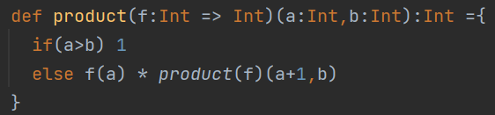
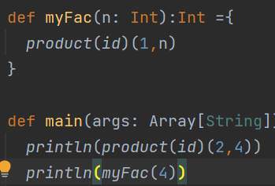
Exercise: factorial in terms of product? – 2 mins
Notes:
object Product { def product(f:Int => Int)(a:Int,b:Int):Int ={ if(a>b) 1 else f(a) * product(f)(a+1,b) } def id(a:Int):Int = a def square(a:Int):Int = a*a def factorial(x: Int, acc: Int): Int ={ if (x ==0) return acc return factorial(x-1,x*acc) } def fac(a: Int):Int = factorial(a,1) def myFac(n: Int):Int ={ product(id)(1,n) } def main(args: Array[String]): Unit = { println(product(id)(2,4)) //2*3*4 println(myFac(4)) println(product(square)(2,4)) //2^2 * 3^2 *4^2 println(product(fac)(2,4)) //2! * 3! * 4! }

Slide 24
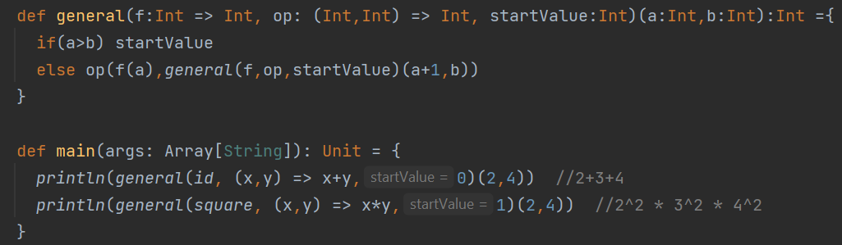
Exercise: write a function that can be changed to use either sum or product (each with 2 parameter list) – 5 mins
Using the new function, in main, calculate 2+3+4 and 2^2 * 3^2 * 4^2
Notes:
object ProductAndSum { def product(f:Int => Int)(a:Int,b:Int):Int ={ if(a>b) 1 else f(a) * product(f)(a+1,b) } def sum(f: Int => Int)(a:Int, b:Int): Int ={ if(a>b) 0 else f(a) + sum(f)(a+1,b) } def id(a:Int):Int = a def square(a:Int):Int = a*a def factorial(x: Int, acc: Int): Int ={ if (x ==0) return acc return factorial(x-1,x*acc) } def fac(a: Int):Int = factorial(a,1) def myFac(n: Int):Int ={ product(id)(1,n) } def general(f:Int => Int, op: (Int,Int) => Int, startValue:Int)(a:Int,b:Int):Int ={ if(a>b) startValue else op(f(a),general(f,op,startValue)(a+1,b)) } def main(args: Array[String]): Unit = { println(general(id, (x,y) => x+y,0)(2,4)) //2+3+4 println(general(square, (x,y) => x*y,1)(2,4)) //2^2 * 3^2 * 4^2 } }

